Slide 1
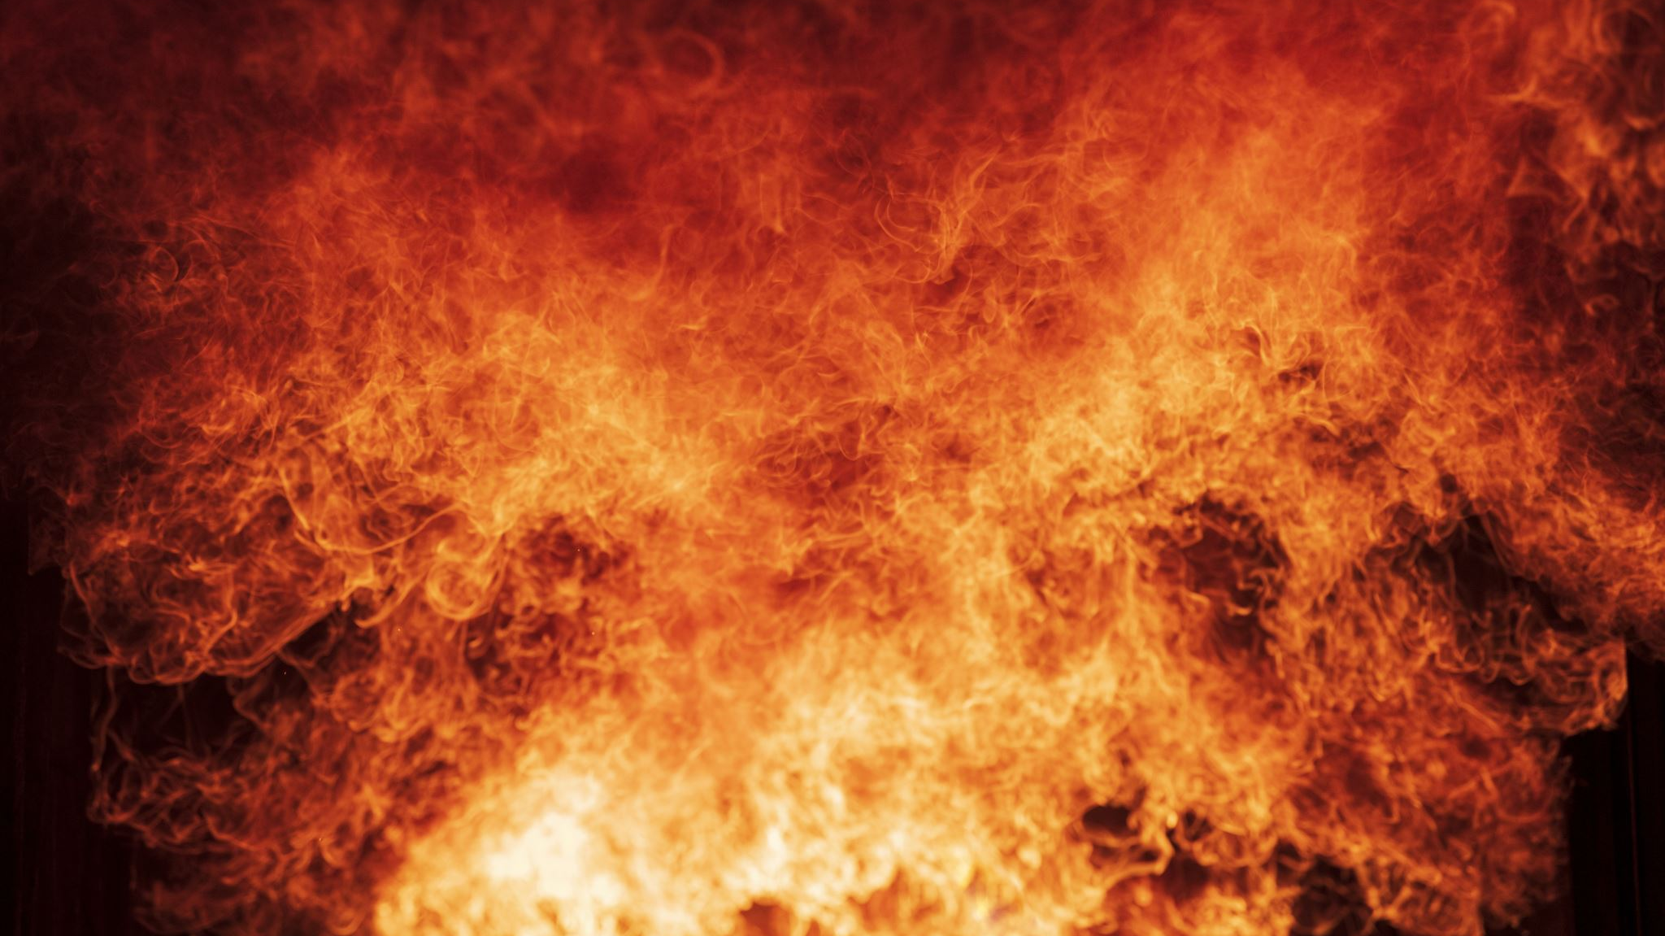
Wildfire Monitoring System
Mark Vernachio and Marcos Ramirez

Slide 2

Project Goals
Monitor Environmental factors(temp, humidity, wind speed)
Provide a secure interface with login authentication
Save and visualize sensor data for analysis
Warn users

Slide 3
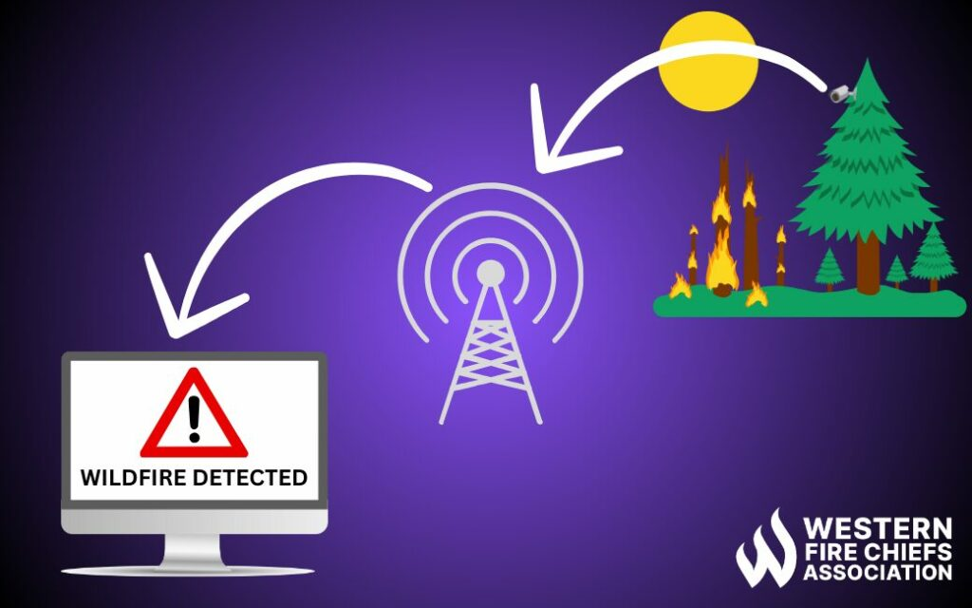
Project Overview
Purpose of the System: Monitoring wildfire conditions through sensors.
Key Features:
Secure login.
Real-time sensor data visualization.
Color coded display to alert level of threat for fire.

Slide 4
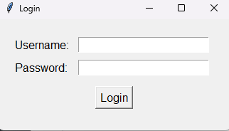
Functionality
Login Screen:
Secure user authentication.
Success callback integrates with main app.
ListView UI:
Real-time sensor data display.
Dynamic background color based on thresholds.
Sensor Threads:
Continuous data generation with CSV storage.
Clamp and simulate values to realistic ranges.

Slide 5
Code integration
LoginScreen Class: Handles authentication.
WildfireListUI Class: Constructs and manages the ListView.
Sensor Class: Simulates data and writes to CSV.
ListViewAppWithLogin Class: Integrates login and ListView.

Slide 6
Data flow
Sensors generate data by utilizing threads
Data is queued and consumed by listview ui
Thresholds on values display different colors (green, yellow, red)

Slide 7
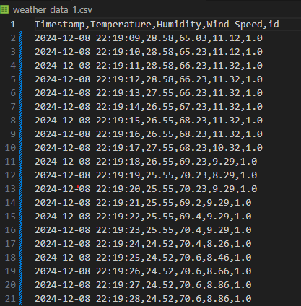
Data Storage
Sensor data is stored periodically in CSV files.
Data includes:
Timestamp
Temperature
Humidity
Wind speed
Allows historical data analysis and backup.

Slide 8
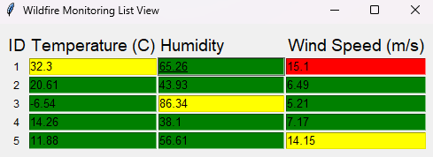
Visual Representation
Login Screen: Demonstrates authentication flow.
ListView UI: Displays sensor data dynamically.
Color-coded warnings:
Green: Normal
Yellow: Warning
Red: Critical

Slide 9
Results
Secure login interface.
Responsive and dynamic UI for monitoring sensors.
Historical data stored in CSVs for analysis.
Real-time updates with critical condition alerts.

Slide 10
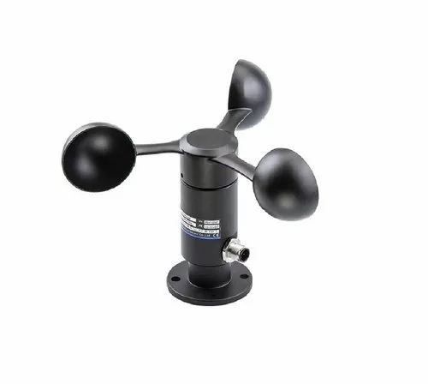
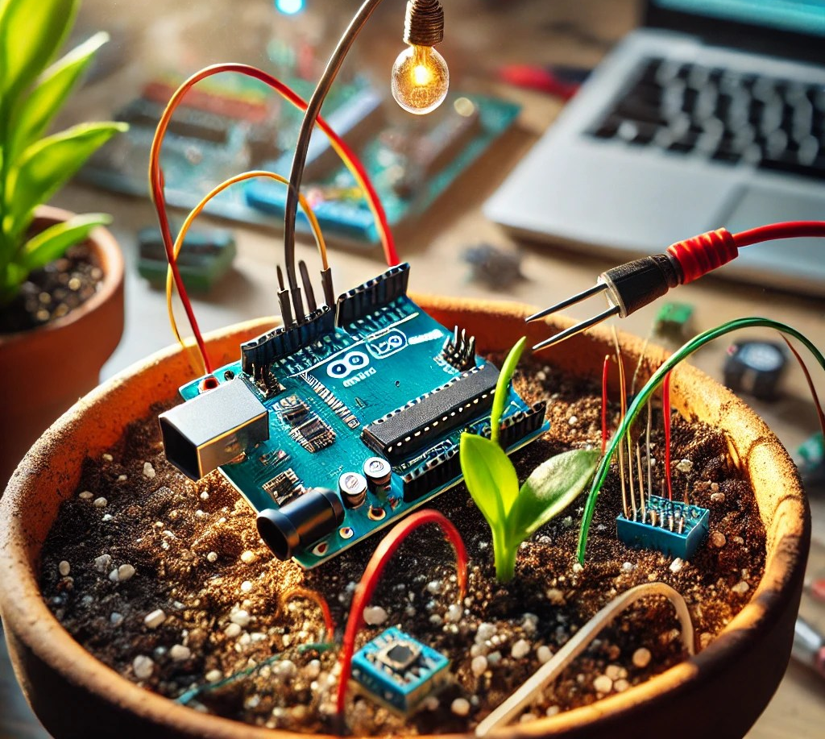
Future Enhancements
Multi-user authentification
Integrate alerts for bad conditions
Utilize actual IOT sensors

Slide 11
Thank you

